Slide 1


Movie Recommender System
Project By
Tim Benjamin Hoffmann
Leveraging the MovieLens Dataset

Slide 2









Motivation The Goal
Recommender System
Movie Recommendations
Movie Data
User Profile
User

Slide 3



Data The MovieLens Dataset: 3 essential files
ratings.csv
Contains 100,836 ratings
Attributes: userId, movieId, rating, timestamp
Each row corresponds to a single rating
Ratings from 0.5 to 5
tags.csv
Contains 3,683 tags (Short descriptive phrase)
Attributes: userId, movieId, tag, timestamp
Each row corresponds to a single tag given by a user to a particular movie
movies.csv
Contains 9,742 movies
Attributes: movieId, title, genres
Each row corresponds to a single movie within the dataset
A movie can have multiple genres associated with it

Slide 4

Modeling Two Models
User-based Collaborative Filtering
Content-based Filtering
Computes similarities between users to predict ratings
Generally provides a diverse set of recommendations
Suffers from data sparsity and scalability issues
Recommends items based only on attributes a user likes
Works well for new items
Tends to recommend a narrow range of items
Evaluation mainly through Precision metric

Slide 5
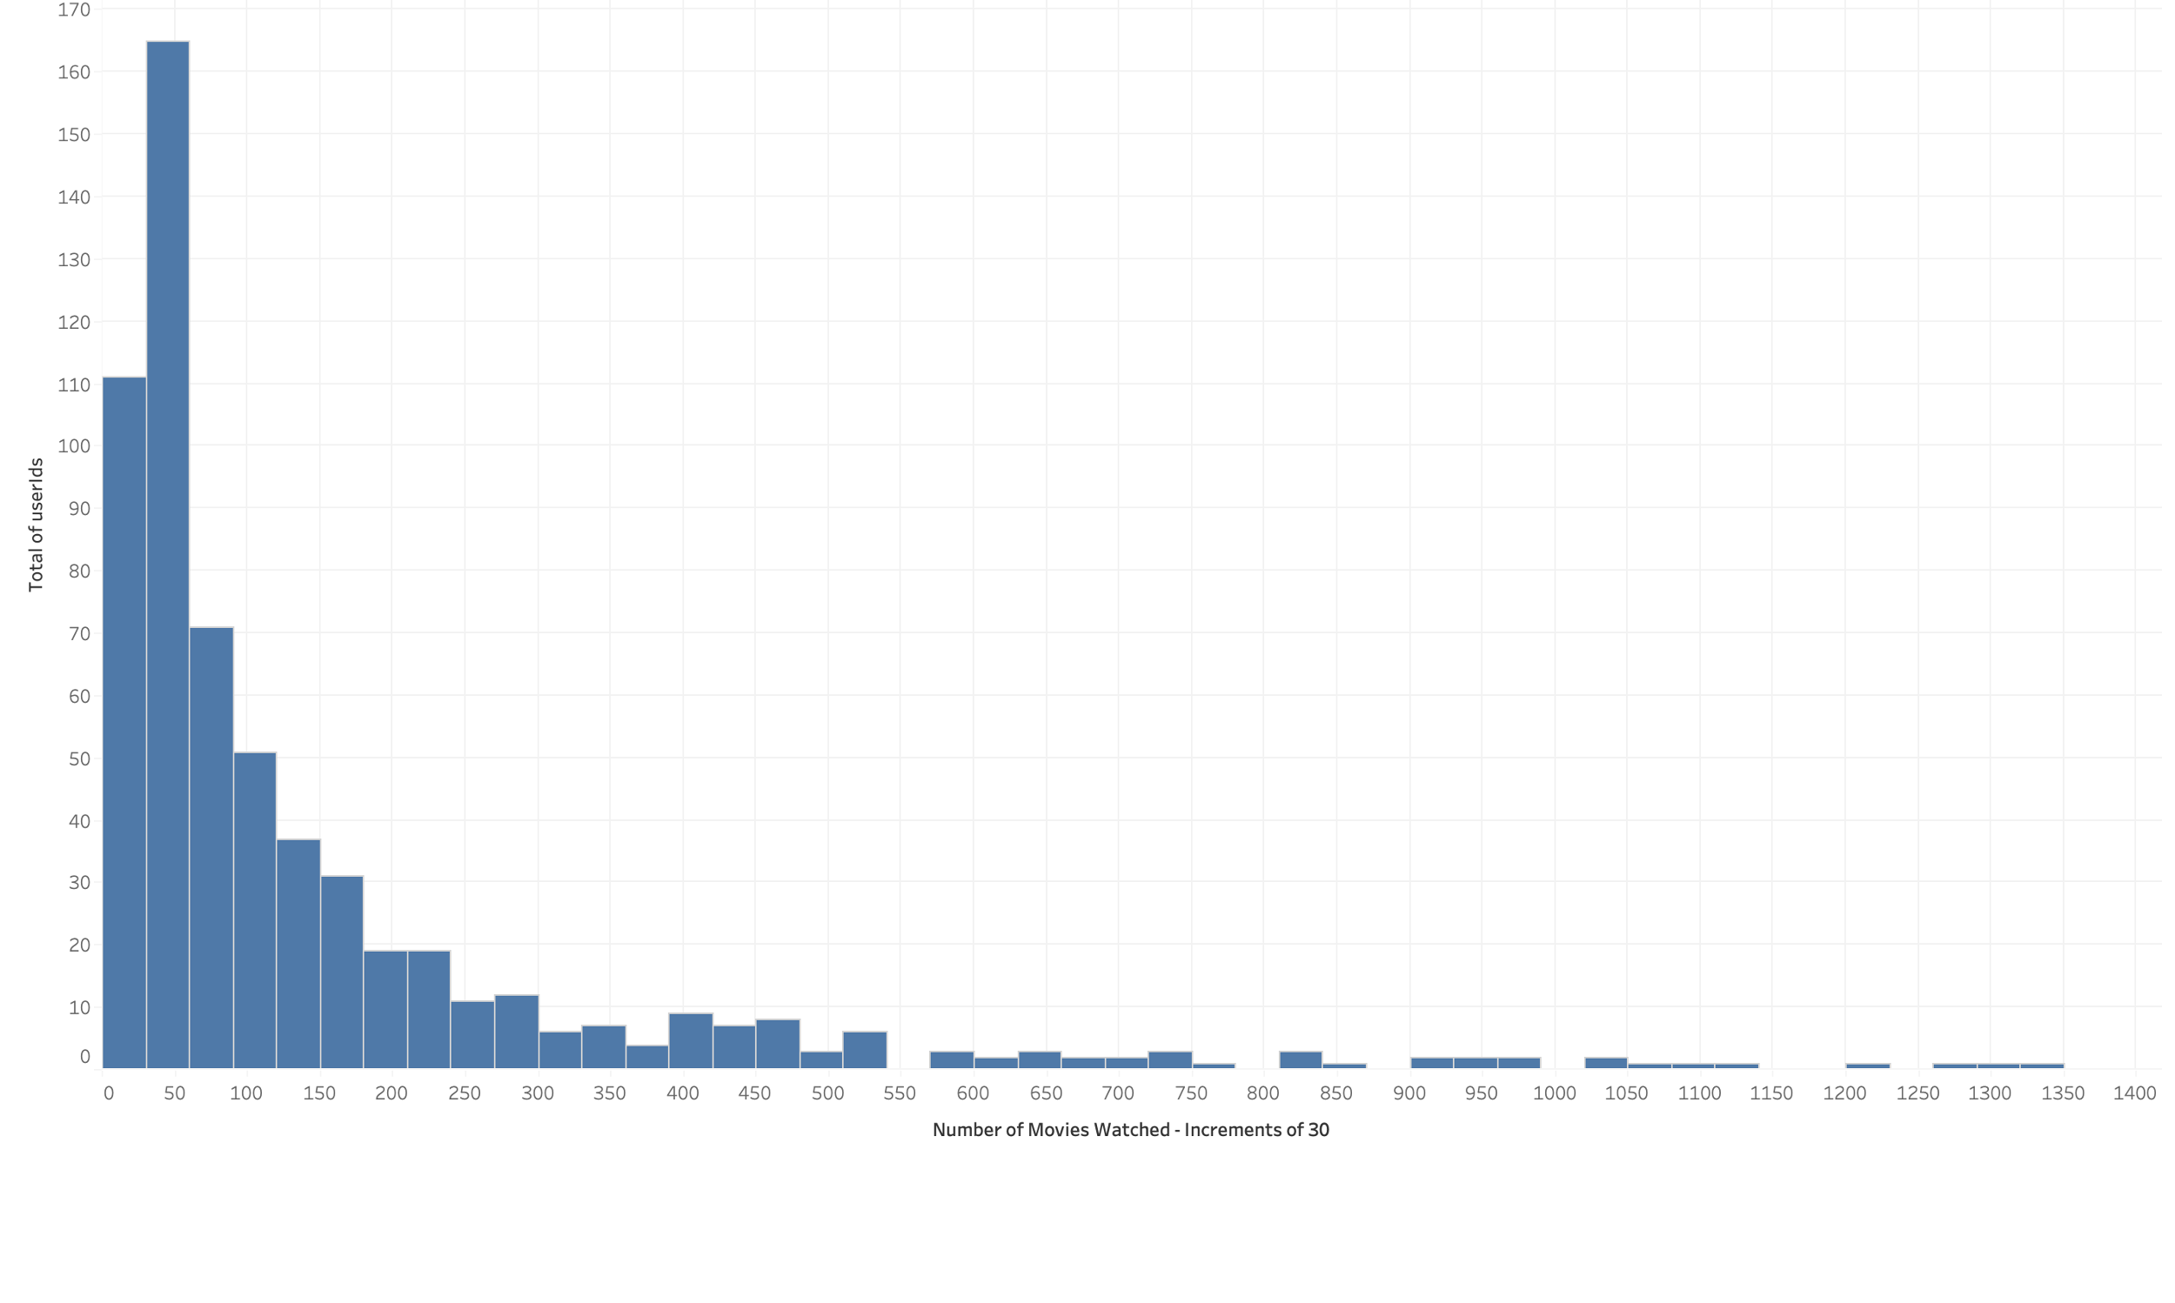
Results Exploratory Analysis
Number of users based on total number of ratings
70 Movies rated
on average (Median)

Slide 6
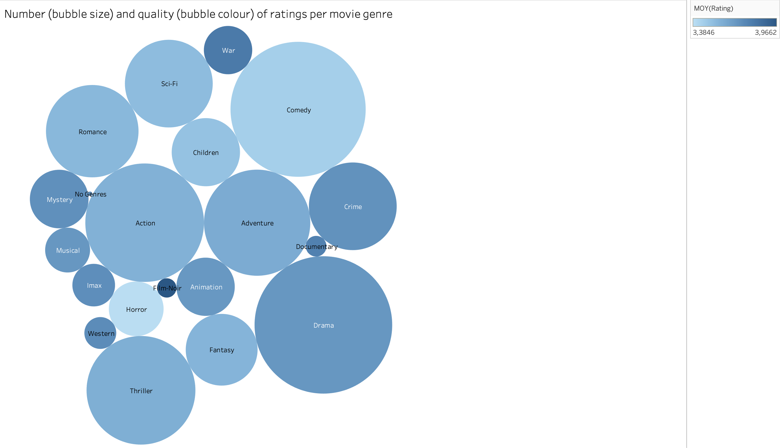
Results Exploratory Analysis
Number (size) and quality (color) of ratings per genre
Number of Ratings
Rating

Slide 7
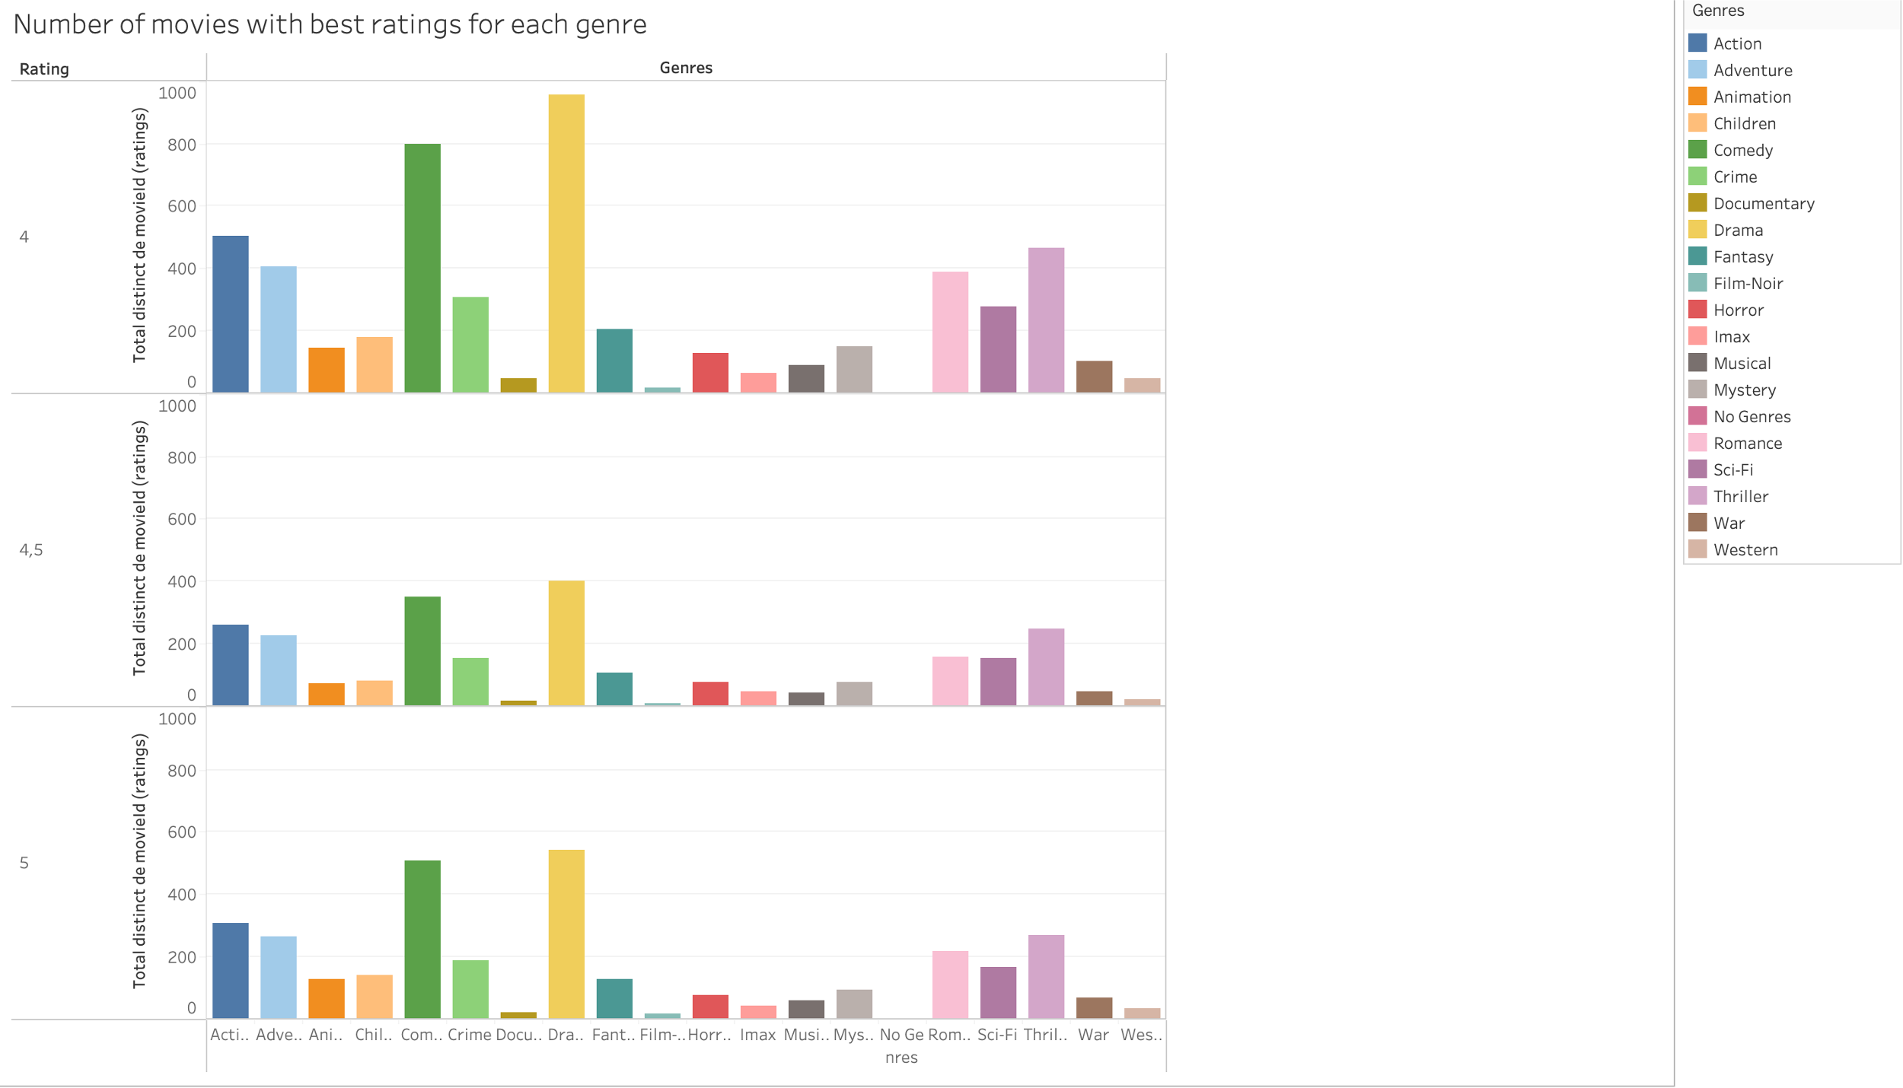
Results Exploratory Analysis
Number of movies with best ratings for each genre
Relative Dominance of frequently rated genres
True quality could be dominated by prevalence

Slide 8
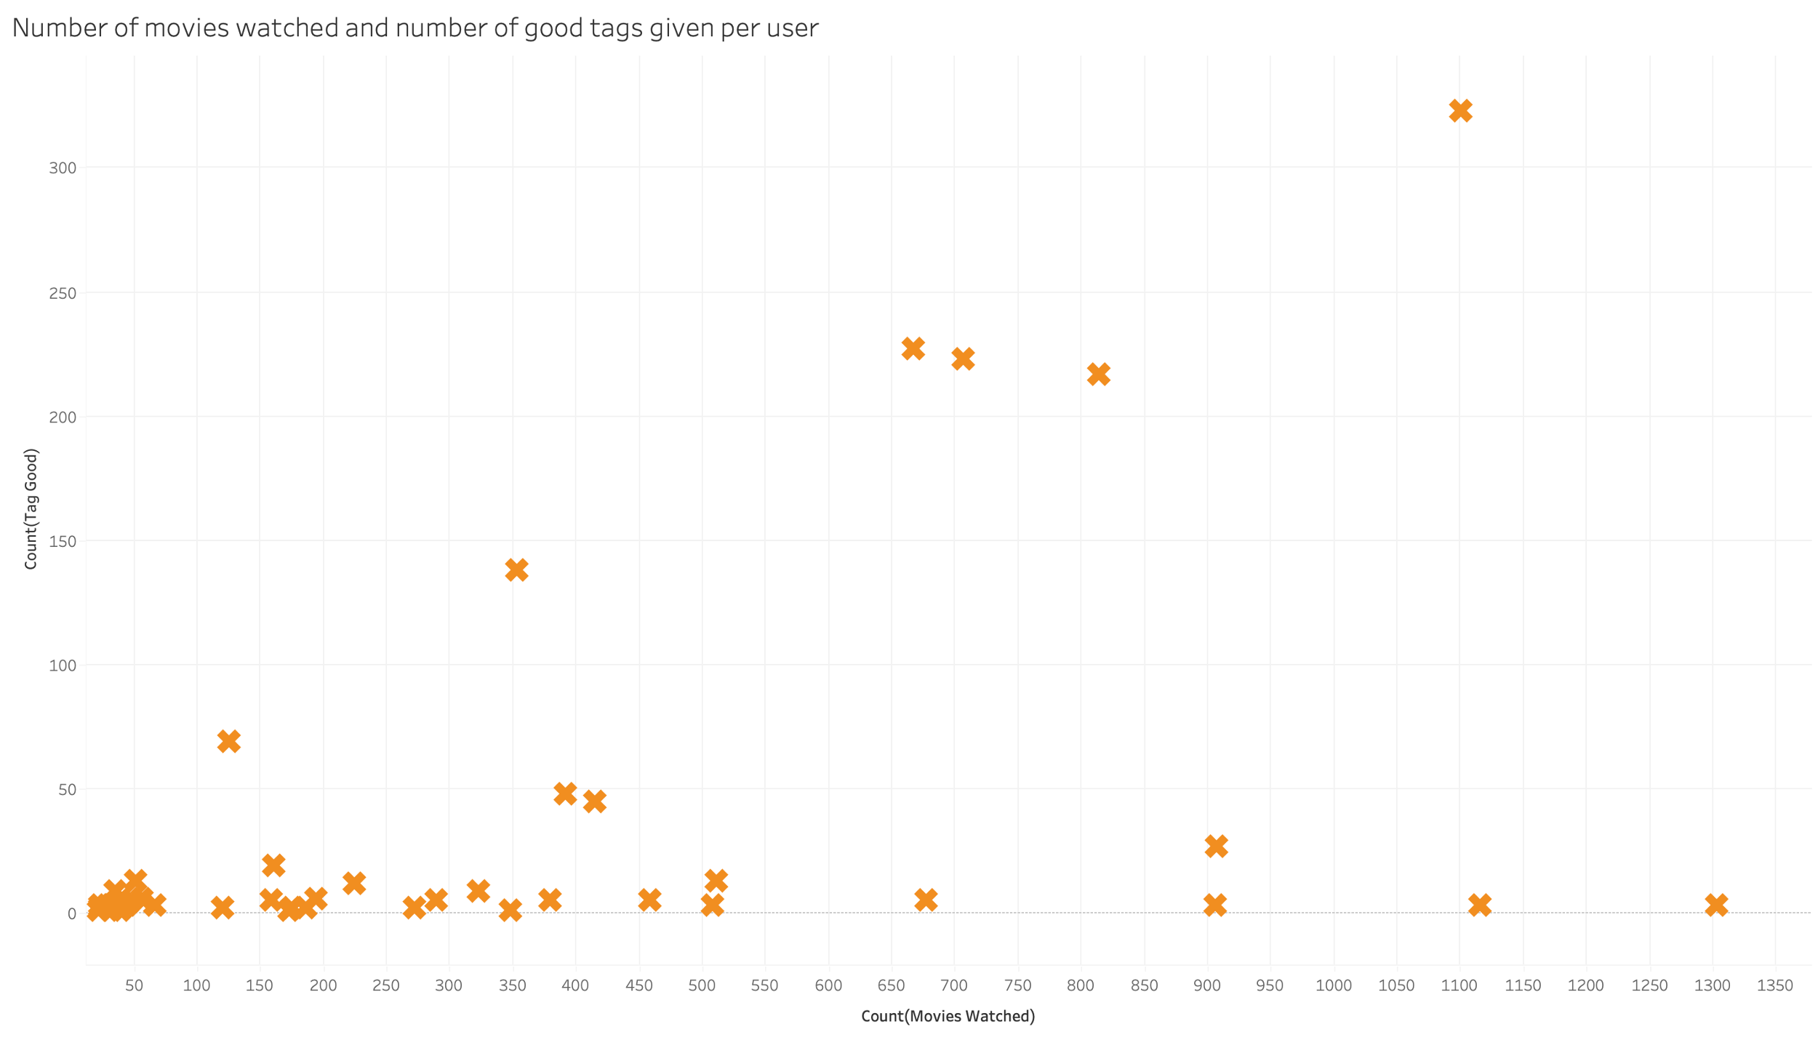
Results Exploratory Analysis
Number good tags given per movies watched
Tags do not correlate with movies watched
Few people provide most of the tags

Slide 9
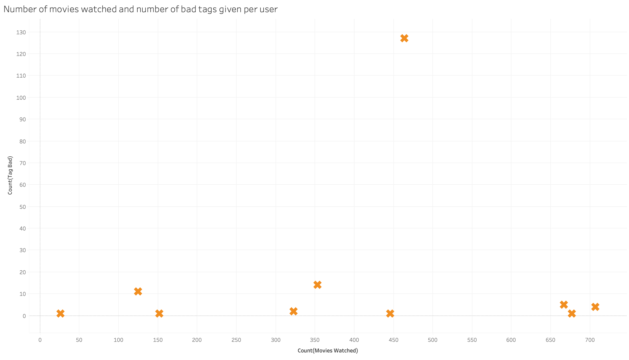
Results Exploratory Analysis
Number good tags given per movies watched
Very few tags associated with bad ratings
Bad tags overly represent the opinions of only ten people (And only one in particular)

Slide 10
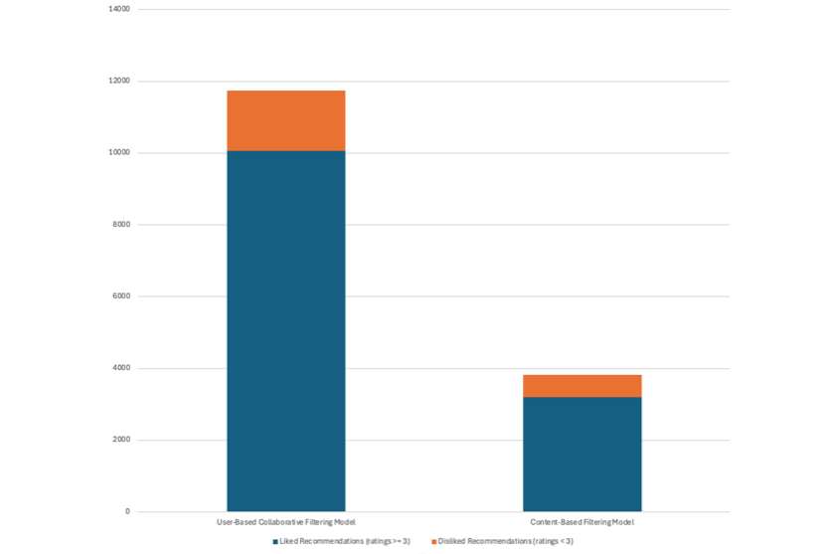
Results Model Evaluation
Number of positive and negative recommendations per model
Testing Strategy
80/20 Train/Test Split per User
Stratified Sampling
Evaluation solely on watched movies in test set
User-based Filtering
Precision: 85.72 %
RMSE: 1.072
Content-based Filtering
Precision: 83.66 %

Slide 11
Results Personal Evaluation
User-based Filtering
Content-based Filtering
Precision: 83.3%
Precision: 80.0 %
 | Tim | Ruhan | Quentin | Total
Liked | 8 | 7 | 10 | 25
Disliked | 2 | 3 | 0 | 5
 | Tim | Ruhan | Quentin | Total
Liked | 7 | 8 | 9 | 24
Disliked | 3 | 2 | 1 | 6
Table 1: Personal evaluation results of user-based collaborative filtering model
Table 2: Personal evaluation results of content-based filtering model

Slide 12
Results Conclusion
Data Exploration provided valuable insights about:
rating distribution
negative quality-quantity correlation
Relative dominance of frequently rated genres
Bias of tags due to limited user pool
Both models achieve a similar quality of recommendations:
CF Precision: 85.72 %, CBF Precision: 83.66 %
Both models have advantages and disadvantages. The preference for one over the other depends on the use-case. Methods can be combined to produce more robust results.

Slide 13
Summary
 | Exploratory Data Analysis of the MovieLens Dataset and Discovery of valuable insights
 | Development of a User-Based Collaborative Filtering Model for Movie Recommendations
 | Development of a Content-Based Filtering Model for Movie Recommendations
 | Evaluation and Comparison of both Models using sampled Test Data
 | Robust Recommendations with similar Precision Metrics between 80-85 %
1
2
3
4
5

Slide 14

Contact
Tim Benjamin Hoffmann
Electrical Engineering Student
E-mail: tim.b.hoffmann@edu.bme.hu

